Slide 1


SQL Notebooks in Azure Data Studio for the DBA
Rob Sewell @SQLDBAWithABeard

Slide 2

Rob Sewell
Bearded Consultant, Automator,
Trainer
Consultant Sewells Consulting Ltd
dbatoolsMoL dbachecks PowerShell & Data Community
beard.media\book
@sqldbawithbeard
SQLDBAWithABeard.com

Slide 3










Thanks to our Sponsors
www.Meetup.com/EdiDpMeetup
Global Partner
GOLD
Silver
Bronze
..and special THANK YOU to our Volunteers (light blue #SQLSat927polo shirt)

Slide 4
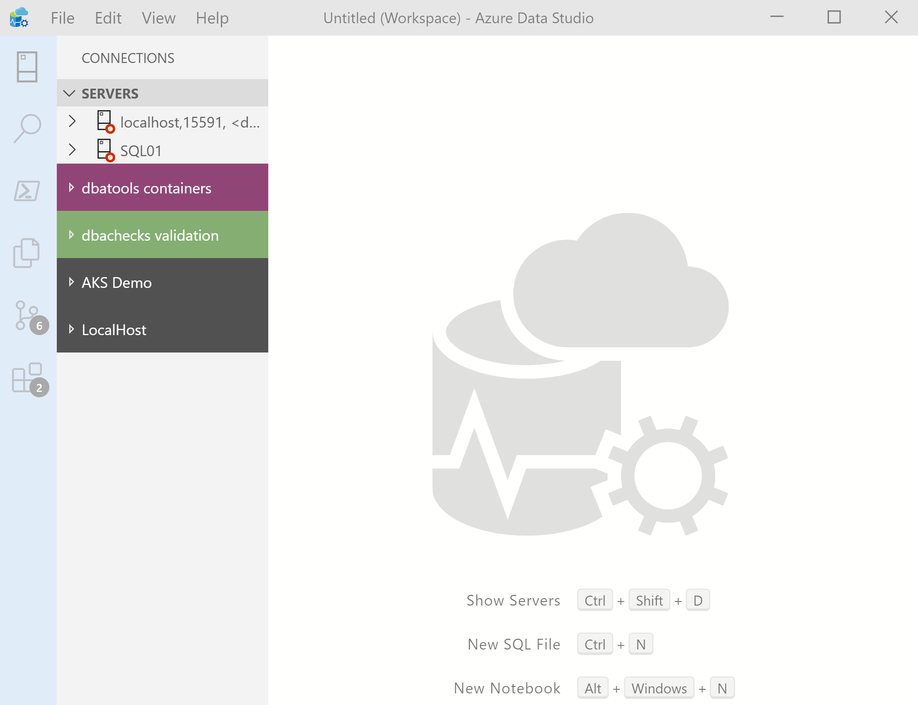
What’s Azure Data Studio ?
Cross Platform desktop environment for Data Professionals

Slide 5

So it’s only for Azure?

Slide 6
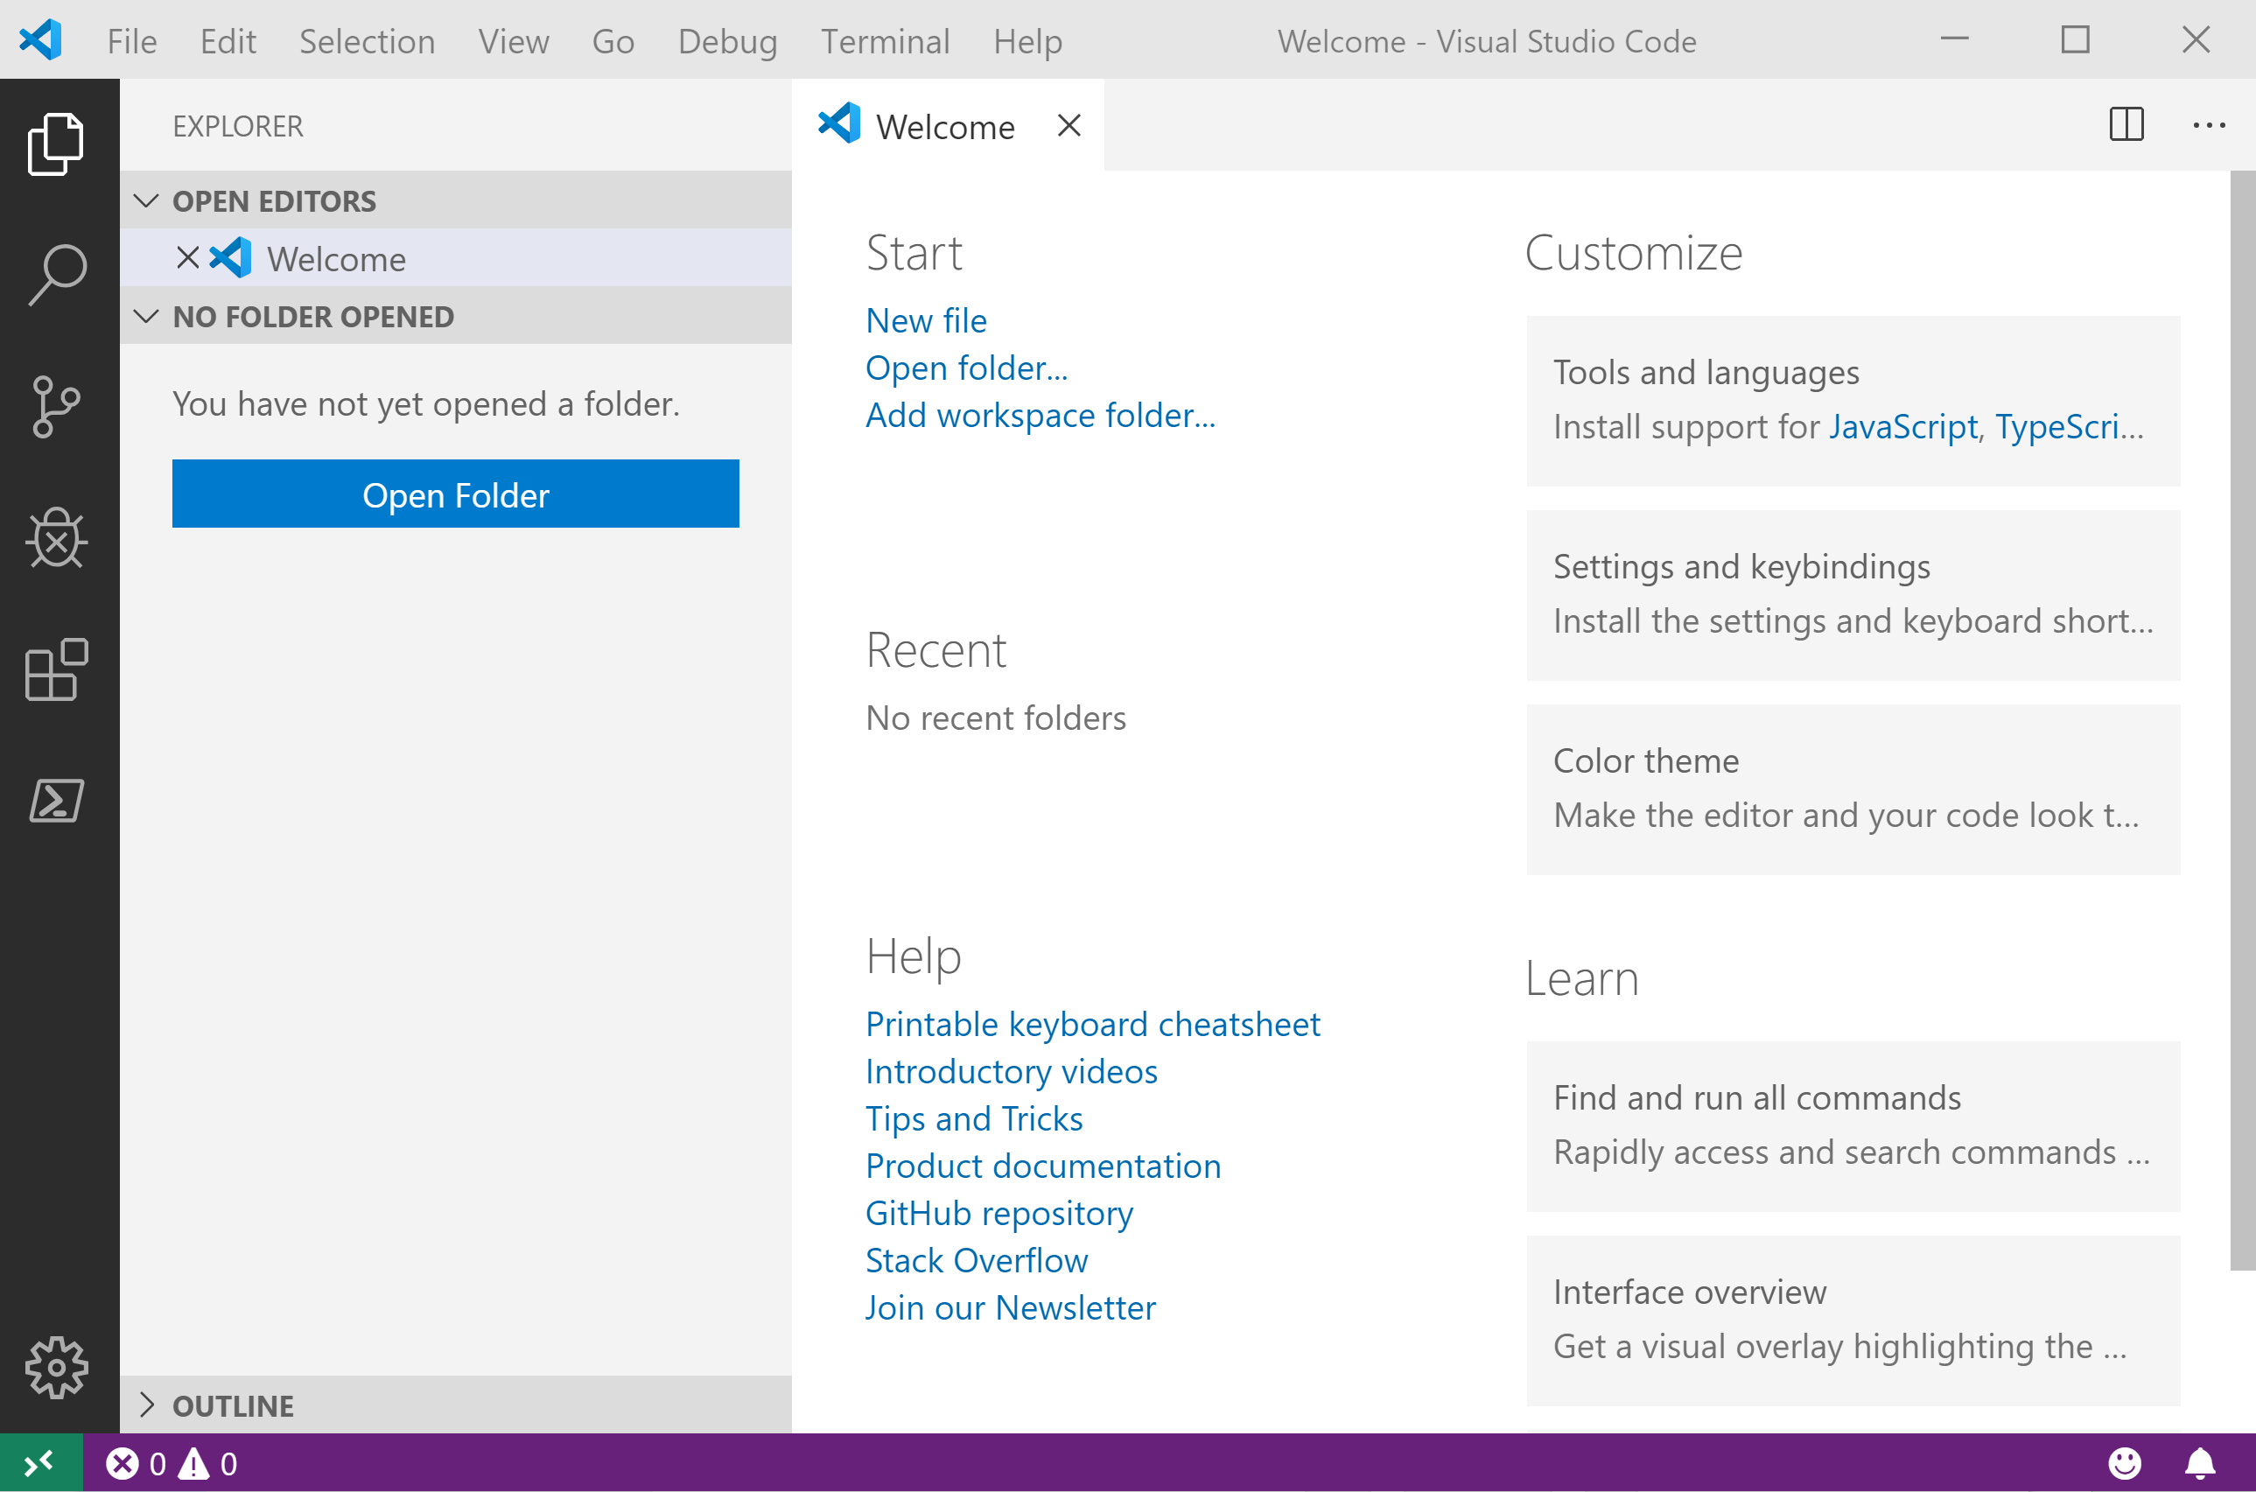
It Looks Like Visual Studio Code ?

Slide 7
It Looks Like Visual Studio Code ?

Slide 8

What is a SQL Notebook?
Originally for Data Scientists

Slide 9
What is a SQL Notebook?
Document that can contain text, code, images and query results

Slide 10
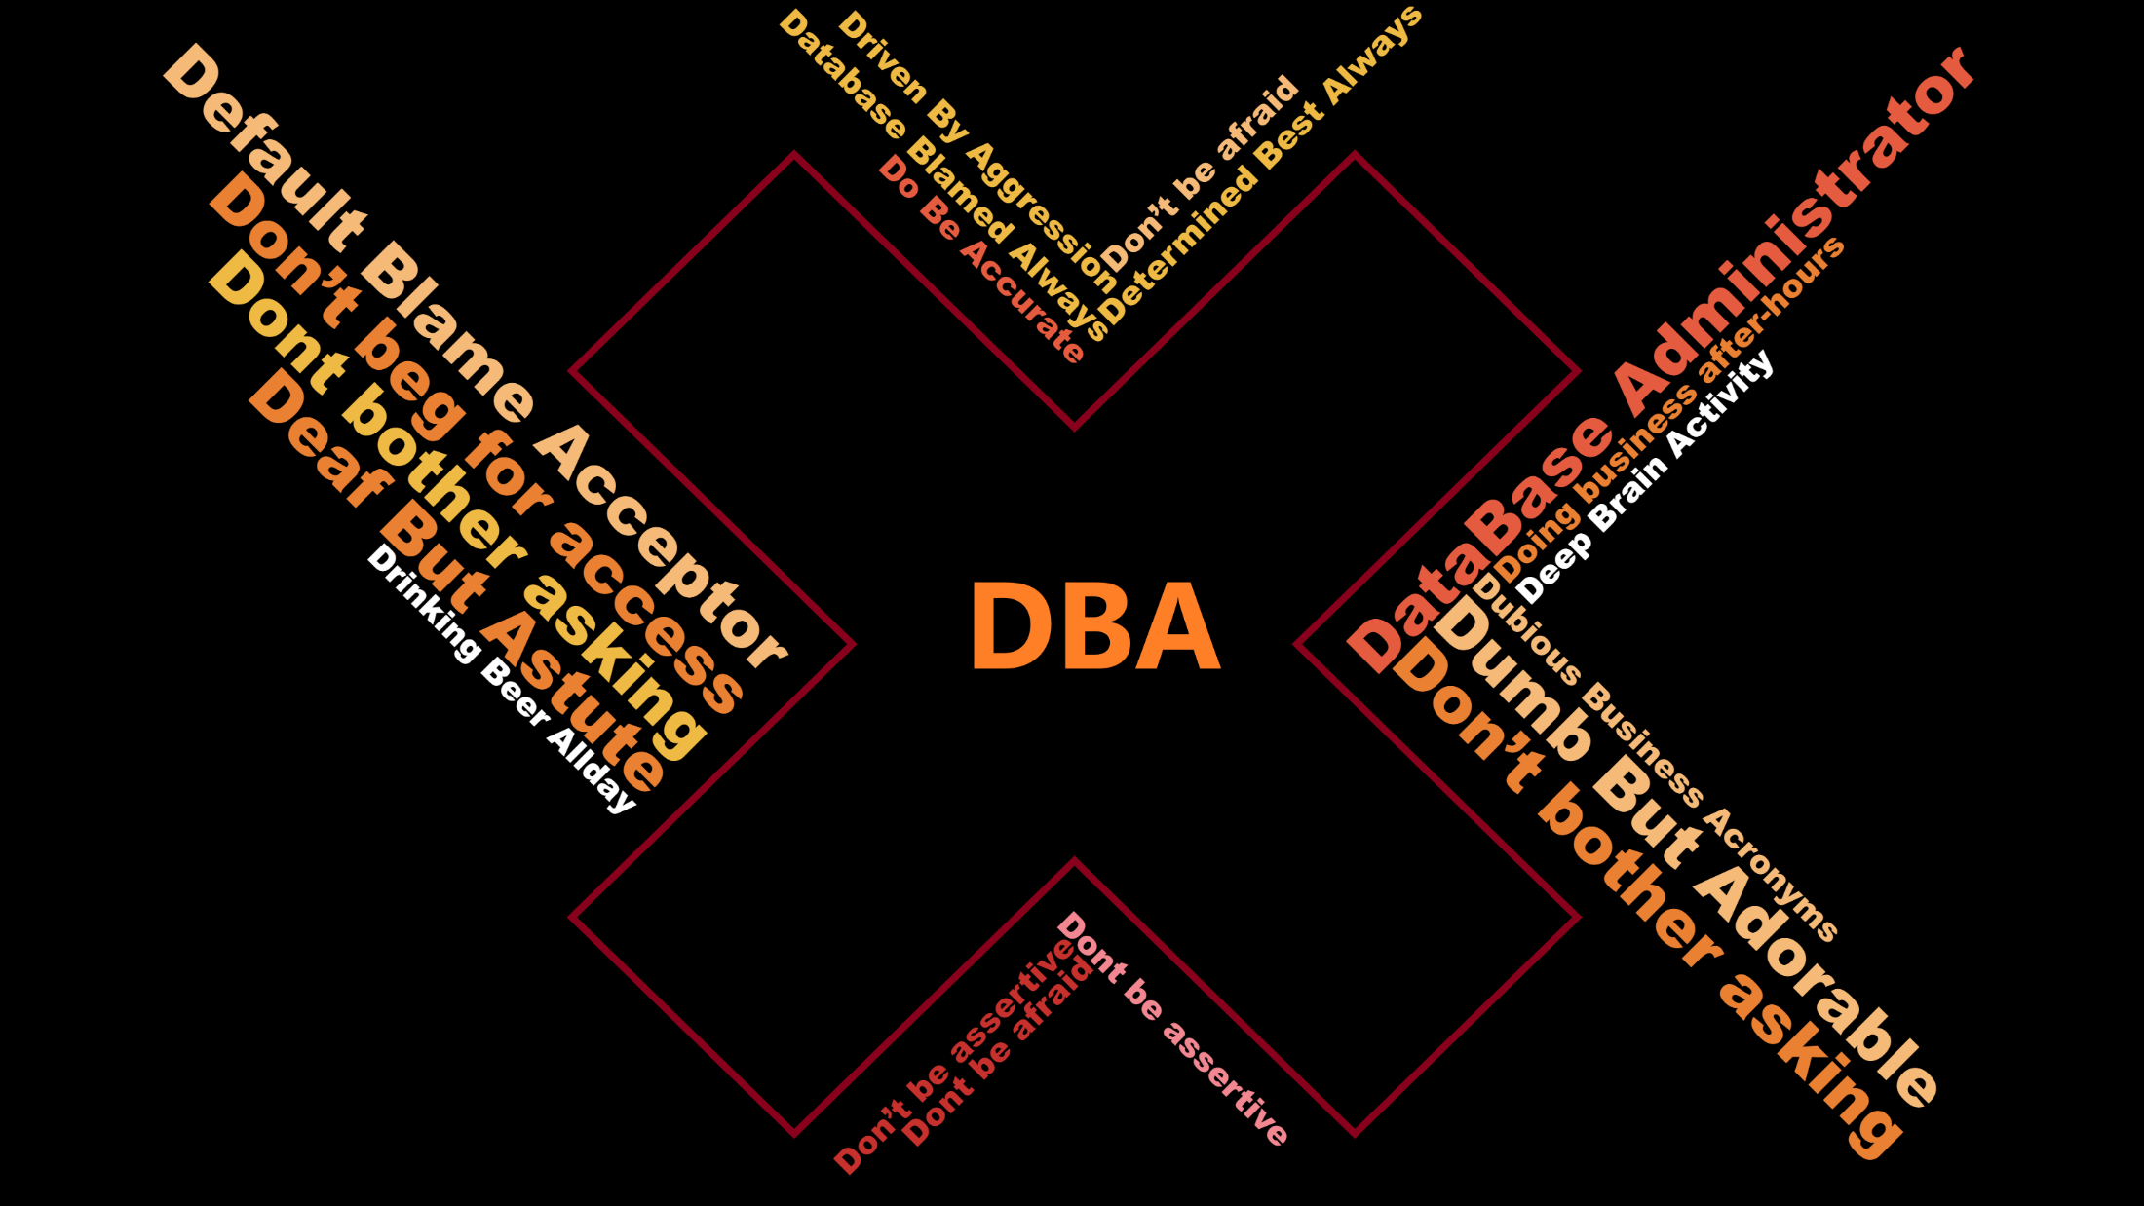

Slide 11

Join us in Houston November 10 – 13, 2020
For the largest gathering of Microsoft
Data Professionals.
Make Plans for PASS Summit 2020
Over 200 sessions by industry experts and 3 days of networking with people just like you. Don’t miss out, future-proof your career at PASSsummit.com

Slide 12







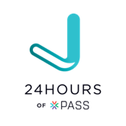


Own your career with Interactive learning built by community and guided by data experts.
1 Attend an event | 2 Join a Community | 3 Explore More Newsletters, Recorded Training, Giving Back
In-person
Get involved. Get ahead.
.org
Online

